Slide 1
GEOGRAPHY AND TIMESTAMP OF SPAM TWEETS
GROUP MEMBER’S:
Anitha Nari - 11550658
Vijayalakshmi pepala - 11656632
Monisha Mahitha boddu - 11513712
Mounika nuchu - 11653658

Slide 2
Introduction:
Sentiment Analysis:
In this project the tweets which are provided in the dataset are preprocessed and cleaned. The data need to be divided based on training data and test data. We have used Naive Bayes classification model for this project. The tweets are determined if they are spam or not. Based on the results the sentiment analysis is performed.

Slide 3
The objective of this study is to conduct a sentiment analysis of tweets and investigate its geographical variations.
The application of Natural Language Processing techniques will be utilized for data preprocessing and sentiment analysis. The data will be analyzed through the use of diverse plots and charts to derive significant insights.
In psychology, the terms sentiment and emotion are sometimes used interchangeably. Sentiment is a mental attitude that is founded on an emotion, whereas emotion is a unique feeling.
However, this distinction is rather hazy, which also applies to the line separating sentiment from opinion. Type, valence (positive, neutral, and negative), and intensity are three components that make up sentiment. It's vital to keep in mind that the thing to which such a sentiment can apply can also change a lot.

Slide 4
Motivation
Twitter stands apart from other online social networks due to its distinctive friend-following and posting features. One the one hand, friendships on Twitter aren't always reciprocal. Users can "follow" celebrities, for instance, without expecting them to do the same.
Each geo-tagged tweet's adjacent location was vectorized as an ego network as well. After that, the vectorized location and word embeddings were combined, and they were input into the CNN and BiLSTM networks to train and categorize the sentiment labels of the tweet.

Slide 5
Objective
Because tweets are brief and noisy, it is difficult to predict where people will be when they will tweet or go home. It is customary to use location- and tweet-specific methods and information while implementing recognition and disambiguation procedures for formal papers.

Slide 6
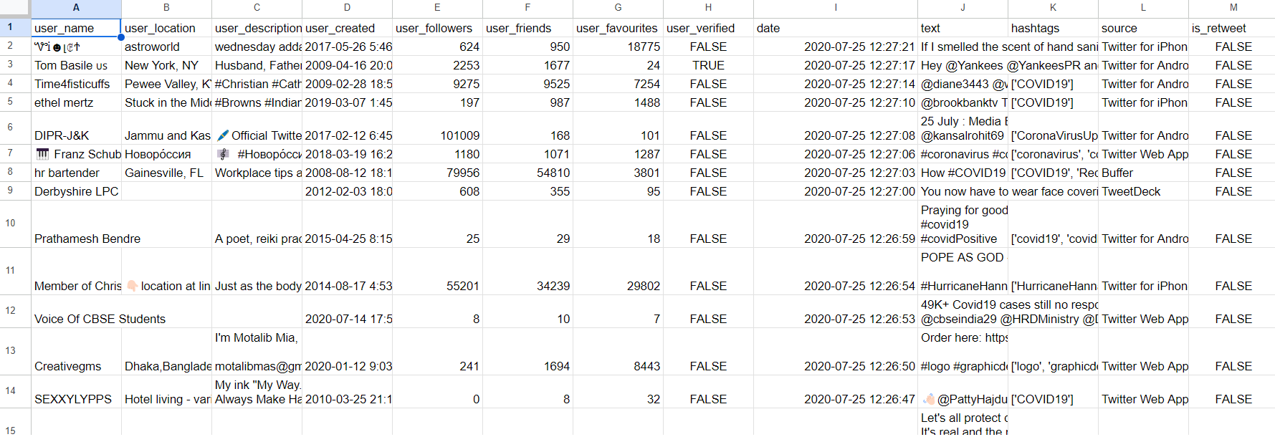
Methodology
Data Collection:
The dataset contains the information of the tweets, Timestamp, dates, location, username, user description, user friends, user followers, user tweets, hashtags, source. The link of the dataset where it is uploaded is shown below in
https://www.kaggle.com/datasets/anithanari/geographyandtimestampofspamtweets

Slide 7
Data Analysis
We have taken the data set from various sources.
Combined the data of Github tweets and Kaggle dataset.
All the tweets are gathered and performed whether they are positive tweets or Negative Tweets.
By using Different Corpus for example NLTK
We have performed the process of Tokenization and Stemming techniques.

Slide 8
Tools
Multiple tools and techniques are used for the detection of spam tweets and their location.
Importing different python libraries like np, numpy, pandas, textblob.
Machine Learning Techniques:
Regression Technique.
Tokenization-NLP technique
Naive Bayes Algorithm.

Slide 9
Running Jupyter Notebooks on your computer locally instead of through Google Colab has a number of benefits: Free GPU and TPU Access: For computation-intensive tasks, Google Colab offered free GPU and TPU access, which significantly sped up our training of machine learning models.
Colab notebooks are easily coupled with cloud storage services like Google Drive, enabling us to access datasets and other information from any location.
Pre-installed Libraries: Because it already has well-known libraries like NumPy, Pandas, and TensorFlow installed, we have saved time by not having to worry as much about installation and package dependencies on the local system.
Collaboration: We used Colab to easily share our notebook with our team members and work together on the project in real time.

Slide 10
Implementation
Running Jupyter Notebooks on your computer locally instead of through Google Colab has a number of benefits: Free GPU and TPU Access: For computation-intensive tasks, Google Colab offered free GPU and TPU access, which significantly sped up our training of machine learning models.
Colab notebooks are easily coupled with cloud storage services like Google Drive, enabling us to access datasets and other information from any location.
Pre-installed Libraries: Because it already has well-known libraries like NumPy, Pandas, and TensorFlow installed, we have saved time by not having to worry as much about installation and package dependencies on the local system.
Collaboration: We used Colab to easily share our notebook with our team members and work together on the project in real time.
There is no need for further software installation because Colab is a cloud-based platform.

Slide 11
Completed Items
We have taken a large dataset and first did the sentiment analysis.
Then used the stop words function on it.
By using google collab as the tool we had ran the python code.
Next we have differentiated the Positive and Negative tweets.
Finally identified what are the locations and the timestamps of the spam tweets with sarcasm as well.

Slide 12
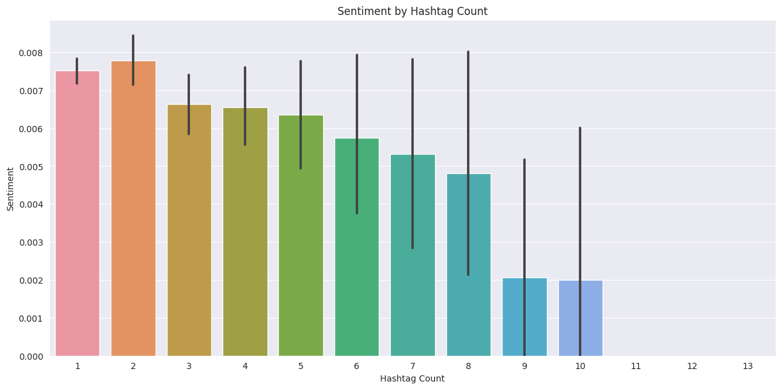
Finally, a similar analysis was made, but this time, the sentiment values was compared to the hashtag count of each tweet. The following was the resulting plot.
Comparison with existing project:
Here we have used large amounts of dataset compared to the references mentioned below and execution time is also less which is 14 to 16sec.

Slide 13
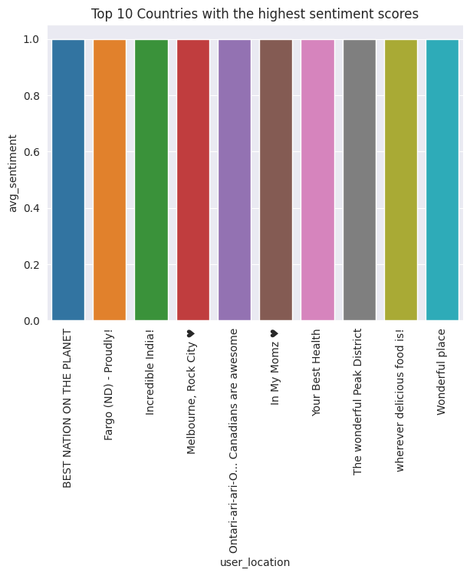
Plot of top 10 locations with highest sentiment scores is shown in the given graph.

Slide 14
Video Link:
https://www.youtube.com/watch?v=Ow5UDUKU_Nk

Slide 15
THANK YOU !!

